Slide 1
Sprint 1 Summary
Eva Operations & Communication Requirements
Shawn Galloway
New Mexico State University
NASA RASC

Slide 2
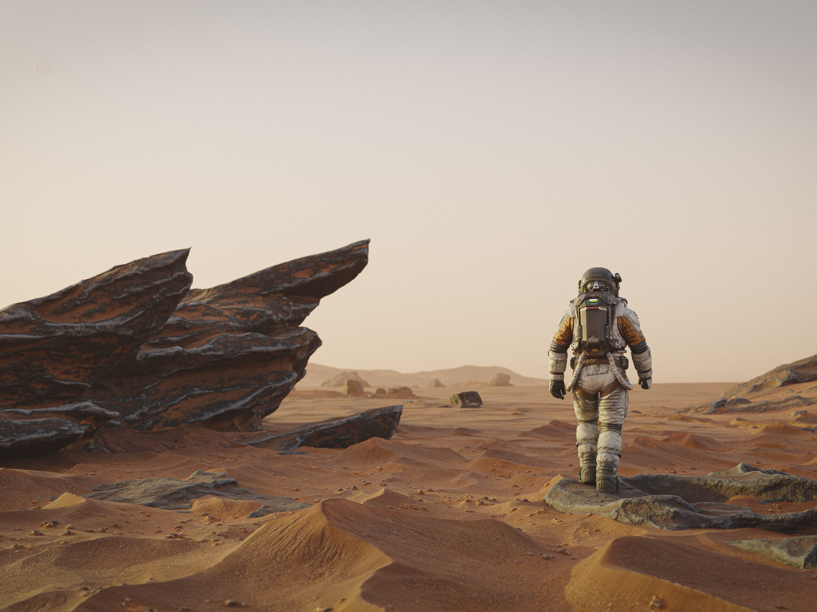
Mission Duration & Size
Mars Mission estimates from NASA, JPL and AIAA in 2009 state:
Total missions time, 900 days.
Mars Surface time, 500 days.
Scientific operations:
Multiple Drilling sites.
Exploration distances of ~300km
Note: Time accounts for astronauts stay until next Mars Transfer. Time shrinks considerably if otherwise.

Slide 3
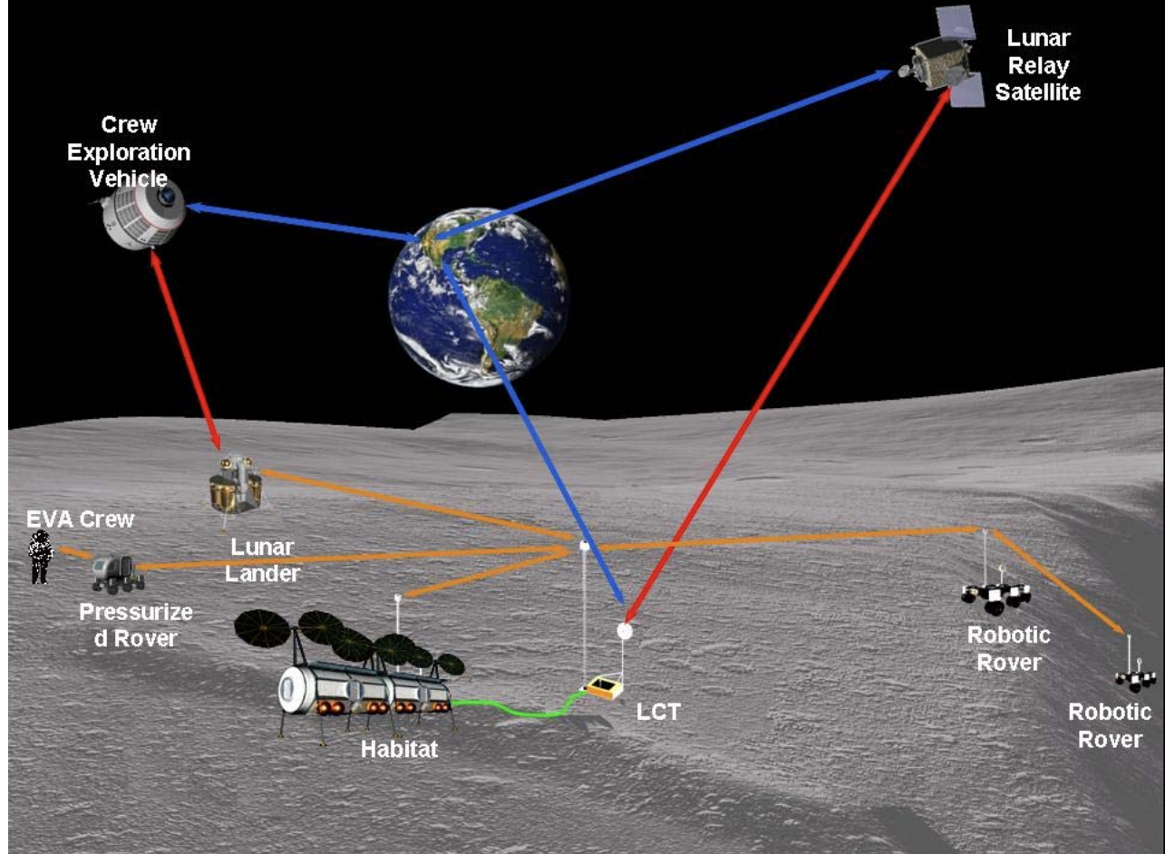
Surface Operations
Mars & Moon missions consistently plan for at least two rover vehicles.
The use of rover communications has been key in solving potential communications gaps.
Communications relay depends on lander systems as well.

Slide 4
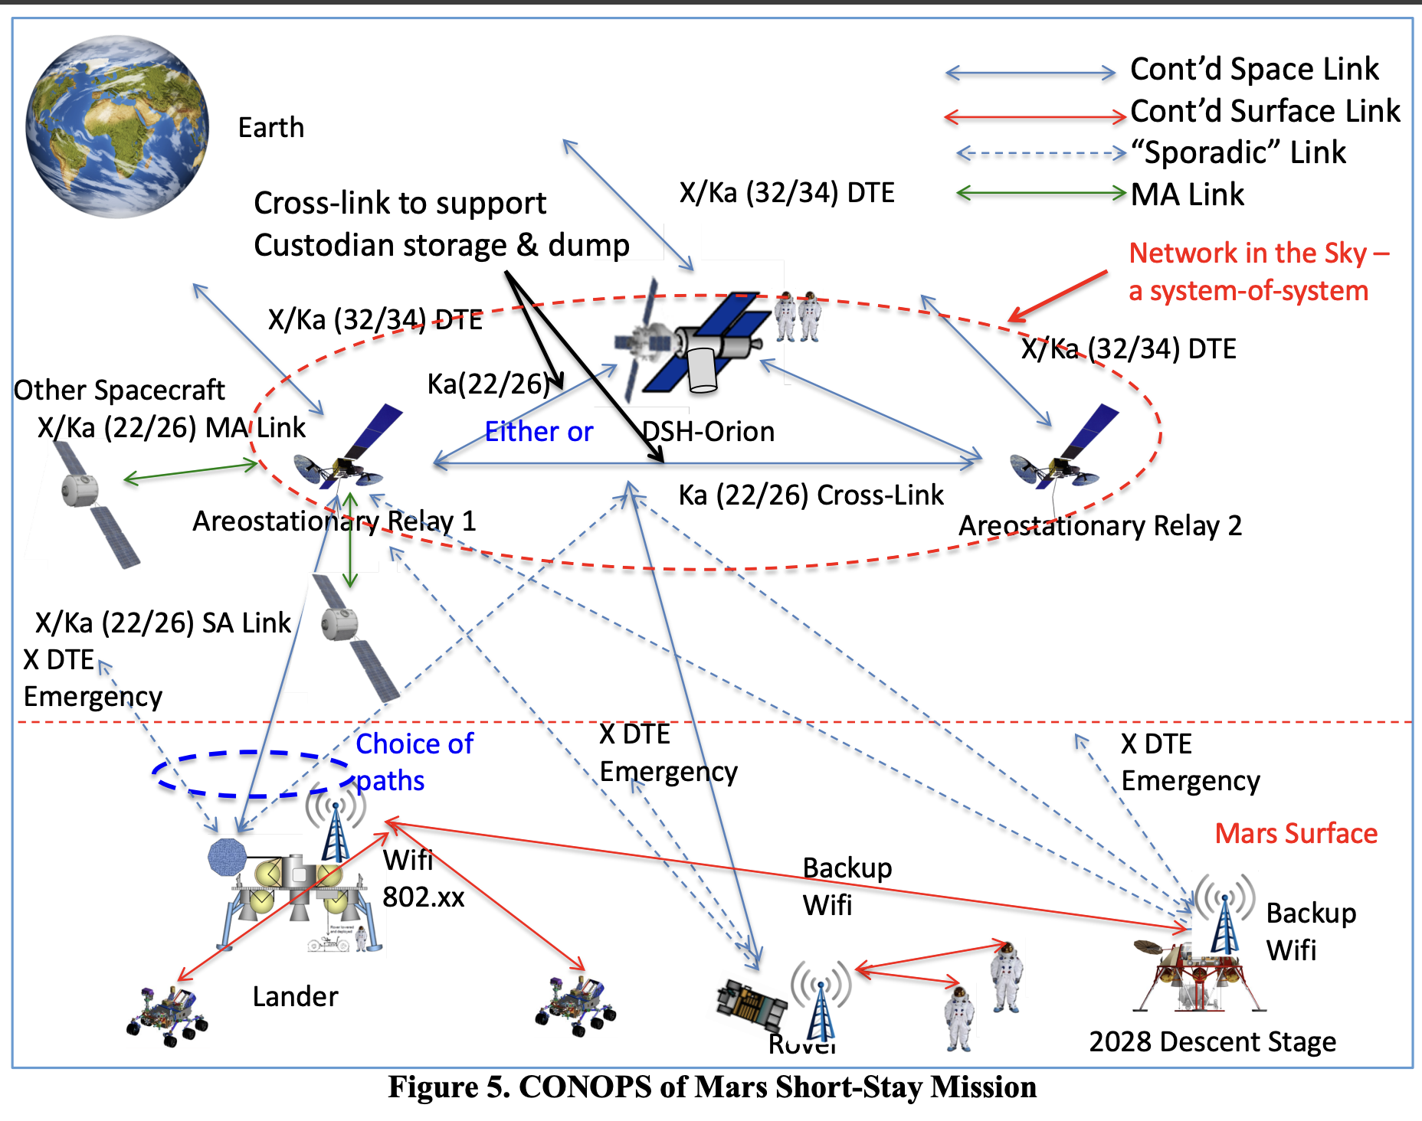
JPL Ideal Requirements
Mars Surface Operations demands:
Continuous Space and Surface Links
Two alternative communications paths to any given astronaut should be maintained.

Slide 5
Key References
AIAA _ NASA Paper 2009: Mars Human Mission of the surface of Mars
AIAA _ NASA Paper 2006: Lunar Communication Terminals
ICES 2023: Decision support system for Extravehicular operations under significant communications latency.
JPL 2018: Mars Planetary Network for Human Exploration Era
AIAA _ NASA 2014: Architecture for an advanced Extravehicular Mobile Unit

